Slide 1

Software Engineering

Slide 2
Object Orientated Principles;
Encapsulation
Encapsulation is the hiding of data implementation by restricting access to accessors and mutators.
An accessor is a method that is used to find out about an object. In OOP, this is usually done in the form of properties, which have a ”get” method, which is an accessor method. However, accessor methods are not restricted to properties and can be any public method that gives information about the state of an object.
Mutators are a public method that is used to modify the state of an object, while hiding the implementation of exactly how the data is modified. It’s the set method that allows the modification of the member data behind the scenes.
Hiding the internals of the object protects its integrity by preventing users from setting the internal data of the component into an invalid or inconsistent state.
A main benefit of encapsulation is that it reduces system complexity

Slide 3
Object Orientated Principles;
Abstraction
Data abstraction and encapsulation are closely tied together, because a simple definition of data abstraction is the development of classes, objects, types in terms of their interfaces and functionality, instead of their implementation details.
Abstraction denotes a model, a view, or some other focused representation for an actual item.
Data abstraction is nothing more than the implementation of an object that contains the same essential properties and actions we can find in the original object we are representing.

Slide 4
Object Orientated Principles;
Inheritance
Inheritance is a way to reuse code of existing objects, or to establish a subtype from an existing object, or both, depending upon programming language support.
Classes can inherit attributes and behaviour from pre-existing classes called base classes, super-classes, parent classes or ancestor classes.
The resulting classes are known as derived classes, subclasses or child classes.
  Subclasses and Super-classes
A subclass is a modular, derivative class that inherits one or more properties from another class (called the superclass).
The properties commonly include class data variables, properties, and methods or functions.
The superclass establishes a common interface and foundational functionality, which specialized subclasses can inherit, modify, and supplement.

Slide 5
Object Orientated Principles;
Polymorphism
Polymorphism means one name, many forms. Polymorphism manifests itself by having multiple methods all with the same name, but slightly different functionality.
Overriding, also known as run-time polymorphism. For method overloading, the compiler determines which method will be executed, and this decision is made when the code is compiled.
Overloading, which is referred to as compile-time polymorphism. This method will be used for method overriding.

Slide 6
Law of Demeter

Slide 7
What is LoD?
LoD is a design principle that helps you minimize coupling.
Its ok to talk to A, its ok to call A.B but its not ok to call A.B.C
Suggests limits on the classes that can be referred to by a given method
Limits the objects that can be referred to
Reduces coupling, but sometimes requires extra wrapper classes
Notes:
Law of Demeter is a style guide line used in Object oriented programming, it governs the communication structure within an Object oriented design.
2

Slide 8
Ocean example
class fish { }
class ocean { }
Public void IsHungry() { }
Notes:
We have a class called ocean
We have a class called fish
In the ocean we put fish so the class ocean will contain the class fish.
The class fish has a method that returns a Boolean to say whether the fish is hungry or not call that ishungry
So the Program has access to the ocean
Ocean has access to the collection of fish
Each fish has a method is hungry.
Say for example we want to list all fish in the ocean that are hungry
It would be wrong to call ocean.fish.ishungy! According to the law of demeter
Instead you would have a separate adapter method in ocean that delegates from fish to is hungry instead of exposing the is hungry method to the ocean.
3

Slide 9
S.O.L.I.D
giggity

Slide 10
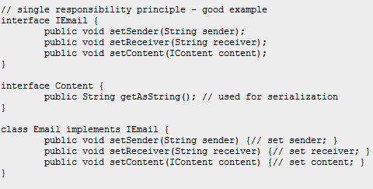
Single responsibility principle
Each class should be restricted to achieve a single task, or handle a single aspect of the application.
A simple change to the application design specification should only change the purpose of a single class
http://www.oodesign.com/single-responsibility-principle.html

Slide 11
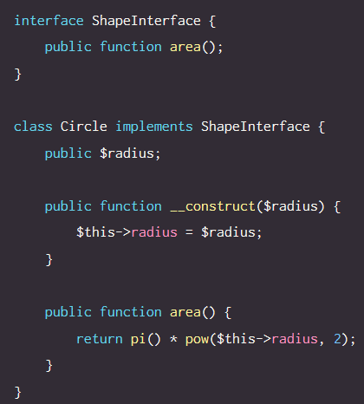
Open/closed principle
Objects and entities in software should be open for extension, but closed for modification from external entities.
Extension of an entity should be easily extendable, with no changes of the base class being required.
i.e. no special casing required
https://scotch.io/bar-talk/s-o-l-i-d-the-first-five-principles-of-object-oriented-design

Slide 12
Liskov Substitution principle
Ability to replace any instance of a parent class with an in instance of one of its child classes without any negative side effects

Slide 13
Example of the Likov’s Substitution Principle
// Violation of Likov's Substitution Principle
class Rectangle
{
protected int m_width;
protected int m_height;
public void setWidth(int width){
m_width = width;
}
public void setHeight(int height){
m_height = height;
}
public int getWidth(){
return m_width;
}
public int getHeight(){
return m_height;
}
public int getArea(){
return m_width * m_height;
}
}
class Square extends Rectangle {
public void setWidth(int width){
m_width = width; m_height = width;
}
public void setHeight(int height){
m_width = height;
m_height = height;
}
}
class LspTest
{
private static Rectangle getNewRectangle()
{
// it can be an object returned by some factory ...
return new Square();
}
public static void main (String args[])
{
Rectangle r = LspTest.getNewRectangle();
r.setWidth(5);
r.setHeight(10);
// user knows that r it's a rectangle.
// It assumes that he's able to set the width and height as for the base class
System.out.println(r.getArea());
// now he's surprised to see that the area is 100 instead of 50.

Slide 14
Interface segregation principle
The Interface Segregation Principle states that clients should not be forced to implement interfaces they don't use. Instead of one fat interface many small interfaces are preferred based on groups of methods, each one serving one submodule.

Slide 15
(Bad) Example of Interface segregation principle
// interface segregation principle
interface IWorker {
public void work();
public void eat();
}
class Worker implements IWorker{
public void work() {
// ....working
}
public void eat() {
// ...... eating in launch break
}
}
class SuperWorker implements IWorker{
public void work() {
//.... working much more
}
public void eat() {
//.... eating in launch break
}
}
class Manager {
IWorker worker;
public void setWorker(IWorker w) {
worker=w;
}
public void manage() {
worker.work();
}
}

Slide 16
(Good) Example of Interface segregation principle
// interface segregation principle
interface IWorker extends Feedable, Workable {
}
interface IWorkable {
public void work();
}
interface IFeedable{
public void eat();
}
class Worker implements IWorkable, IFeedable{
public void work() {
// ....working
}
public void eat() {
//.... eating in launch break
}
}
class Robot implements IWorkable{
public void work() {
// ....working
}
}
class SuperWorker implements IWorkable, IFeedable{
public void work() {
//.... working much more
}
public void eat() {
//.... eating in launch break
}
}
class Manager {
Workable worker;
public void setWorker(Workable w) {
worker=w;
}
public void manage() {
worker.work();
}
}

Slide 17
Dependency inversion principle
Dependency Inversion Principle states that we should decouple high level modules from low level modules, introducing an abstraction layer between the high level classes and low level classes. Further more it inverts the dependency: instead of writing our abstractions based on details, the we should write the details based on abstractions.

Slide 18
(Bad) Example of Inversion Principle
// Dependency Inversion Principle - Bad example
class Worker {
public void work() {
// ....working
}
}
class Manager {
Worker worker;
public void setWorker(Worker w) {
worker = w;
}
public void manage() {
worker.work();
}
}
class SuperWorker {
public void work() {
//.... working much more
}
}

Slide 19
(Good) Example of Inversion Principle
// Dependency Inversion Principle - Good example
interface IWorker {
public void work();
}
class Worker implements IWorker{
public void work() {
// ....working
}
}
class SuperWorker implements IWorker{
public void work() {
//.... working much more
}
}
class Manager {
IWorker worker;
public void setWorker(IWorker w) {
worker = w;
}
public void manage() {
worker.work();
}
}

